Slide 1


Proofs
By Ariel Avshalom
Lecture 3: Contrapositives and Congruence
CISC 2210

Slide 2

What we’ll cover:
Equivalent, but not equal
Chapter 9 of the book https://www.people.vcu.edu/~rhammack/Discrete/Alpha.pdf
Specifically, congruence and the contrapositive method of proving

Slide 3
Refresher: the Mod operation
The mod operation (%) gives you the remainder or residue of two numbers
Examples:
5 mod 3 = 2
10 % 5 = 0
3 mod 7 = 3
5 mod 0 = undefined

Slide 4

Example: the Mod 5 Class
If you feed any integer into the function
$$\left\{x mod 5 \right| x is an integer\}$$
You’ll get one of 5 outputs:
$$\{0, 1, 2, 3, 4\}$$
This is because the biggest residue you can get when you divide by 5 is 4 and the smallest is when a number divides by 5 exactly.

Slide 5
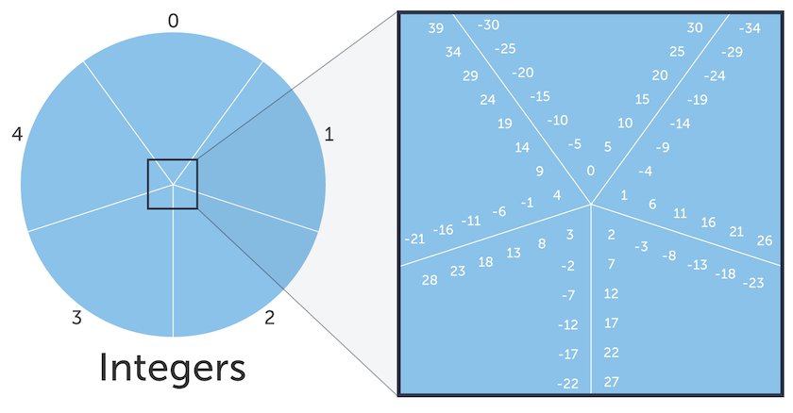

A graphical overview of Mod 5
Each integer you feed into the Mod 5 fits into 1 of 5 slices:

Slide 6

Congruence
The question congruence attempts to ask is, if we select an integer, can we find integers equivalent to it under a function like Modulo.
Examples:
$$3 mod 2 = 5 mod 2 = 7 mod 2 = 2$$
$$17 mod 13 = 4 mod 13 = −9 mod 13 = 4$$
We write these equivalence classes like so:
$$3 ≡5 mod 2 == 3 mod 2=5 mod 2$$

Slide 7
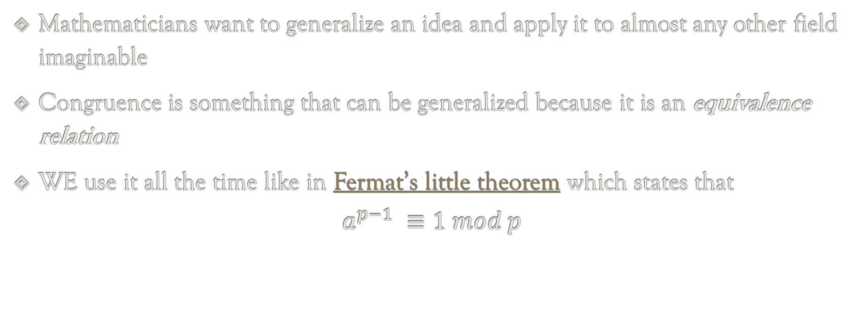
Why is this important?
In H*LL
Mathematicians want to generalize an idea and apply it to almost any other field imaginable
Congruence is something that can be generalized because it is an equivalence relation
WE use it all the time like in Fermat’s little theorem which states that
$$a^{p−1} ≡1 mod p$$

Slide 8
What is an equivalence relation?
An equivalence relation has 3 properties:
Reflexive : A is related to A
Symmetric : if A is related to B, then B is related to A
Transitive : if A is related to B and B is related to C then A is related to C

Slide 9

Example: Mod 5 equivalence relation
Reflexive:
$$3 ≡3 mod 5=3$$
Symmetric:
If
$$3 ≡8 mod 5$$
Then
$$8 ≡3 mod 5$$
Transitive
If
$$3 ≡8 mod 5$$
And
$$8 ≡18 mod 5$$
Then
$$3 ≡18 mod 5$$

Slide 10
Pick a slice and show equivalence
Each integer in a slice shares an equivalence relationship with its neighbors

Slide 11
In short:
An equivalence relation is a nice way to make precise the manner in which we can regard two things as the same
Examples: pairs of shoes
If you have a pair of bubblegum colored Nike shoes, the left and right shoes are equivalent to each other even if they aren’t equal.
You can also draw an equivalence between all left pairs and all right pairs even though the shoes are different

Slide 12
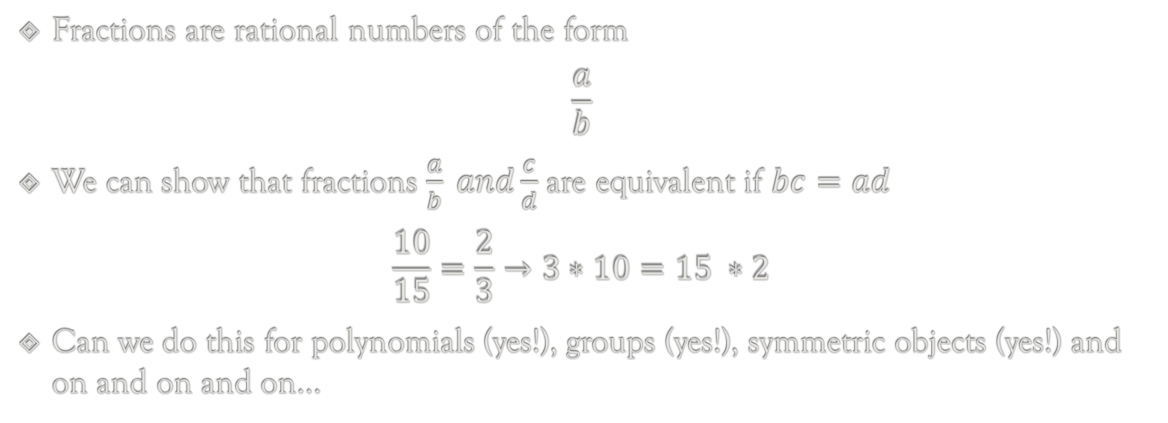
Math example:
Fractions are rational numbers of the form
$$\frac{a}{b}$$
We can show that fractions $\frac{a}{b} and\frac{c}{d}$ are equivalent if $bc=ad$
$$\frac{10}{15}=\frac{2}{3}→3∗10=15 ∗2$$
Can we do this for polynomials (yes!), groups (yes!), symmetric objects (yes!) and on and on and on…

Slide 13
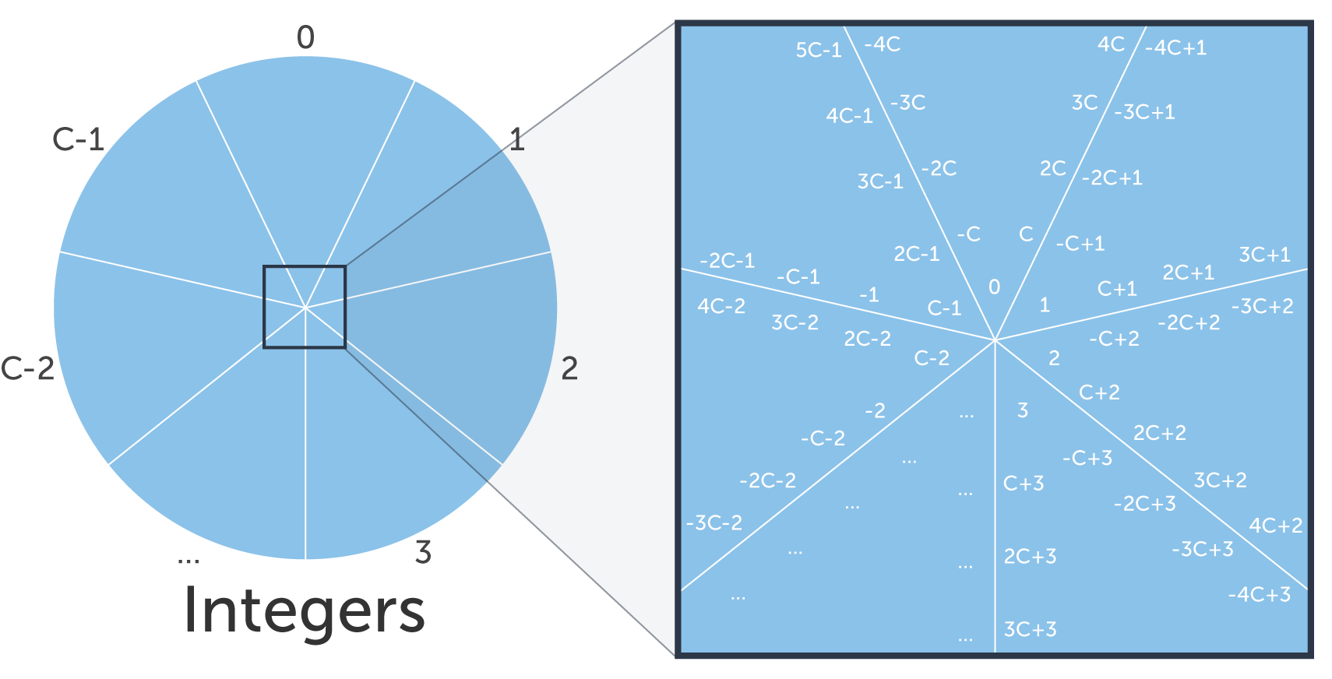
Congruence in the general case

Slide 14
Properties of congruence
Definition. Let a and b be integers and m be a natural number. Then a is congruent to b modulo m: a ≡ b (mod m) if m|(a − b).
The number m is called the modulus of the congruence. Congruence modulo m divides the set ℤ of all integers into m subsets called residue classes.
For example, if m = 2, then the two residue classes are the even integers and the odd integers.
Integers a and b are in the same class if and only if a ≡ b (mod m). The following basic properties follow from the definition of congruence.

Slide 15
Properties 1-3
Property 1. Congruence if reflexive, i.e., a ≡ a (mod m) for every integer a and natural number m.
Property 2. Congruence is symmetric, i.e., if a ≡ b (mod m), then b ≡ a (mod m).
Property 3. Congruence is transitive, i.e., if a ≡ b (mod m) and b ≡ c (mod m), then a ≡ c (mod m).

Slide 16
Properties 4-6
Property 4. Congruences may be added: if a ≡ b (mod m) and c ≡ d (mod m), then a + b ≡ c + d (mod m).
Property 5. Congruences may be multiplied: if a ≡ b (mod m) and c ≡ d (mod m), then ab ≡ cd (mod m).
Property 6. Both sides of a congruence may be divided by a number relatively prime to m: if ab ≡ ac (mod m) and (a, m) = 1, then b ≡ c (mod m).

Slide 17

Contrapositive Proofs
Contrapositive proofs are proved the same way as direct proofs, except…
We flip and negate the proposition
Before, we used to prove:
$$If P →Q$$
Now, we’ll prove:
$$If ¬Q → ¬P$$
Which you’ll recall shares equivocal logic

Slide 18
Why try a contrapositive method?
Sometimes its really hard to prove something in one direction
So instead try to prove the negation in the opposite way
(Also called the contrapositive)

Slide 19
Mathematical writing
The book offers a lot of insight into the correct way to write a proof
Study section 9.3! Writing a proof takes practice and effort
In future courses, being able to do this is a huge boon

Slide 20
The Euclidean algorithm
We won’t cover this in this section of the course, but its worth reading and is a very useful algorithm to know

Slide 21

Contrapositive example:
Suppose n ∈ ℤ. If $n^{2}$ is odd, then n is odd.
Let P = $n^{2} is odd$, Q = $n is odd$
We need to prove that $P →Q$ or $¬P←¬Q$ (Note the arrow can be written in reverse)
$$¬P=n^{2} is even, ¬Q=n is even$$
If n is even then$∃k ∈\text{ℤ}\text{, }\text{s}\text{.}\text{t}\text{. }n=2k$
Then $n^{2} =(2{k)}^{2}= 4k^{2}=2\left(2k^{2}\right) which is even$
From the logical equivalence of contrapositive, we prove that If $n^{2}$ is odd, then n is odd
Q.E.D.

